Slide 1

AtliQ Hospitality Analysis

Slide 2
Introduction
Atliq Grands owns multiple five-star hotels across India. They have been in the hospitality industry for the past 20 years. Due to strategic moves from other competitors and ineffective Management decision-making, Atliq Grands is losing its market share and revenue in the luxury/business hotels category. As a strategic move, the managing director of Atliq Grands wanted to incorporate “Business and Data Intelligence” to regain their market share
and revenue.

Slide 3
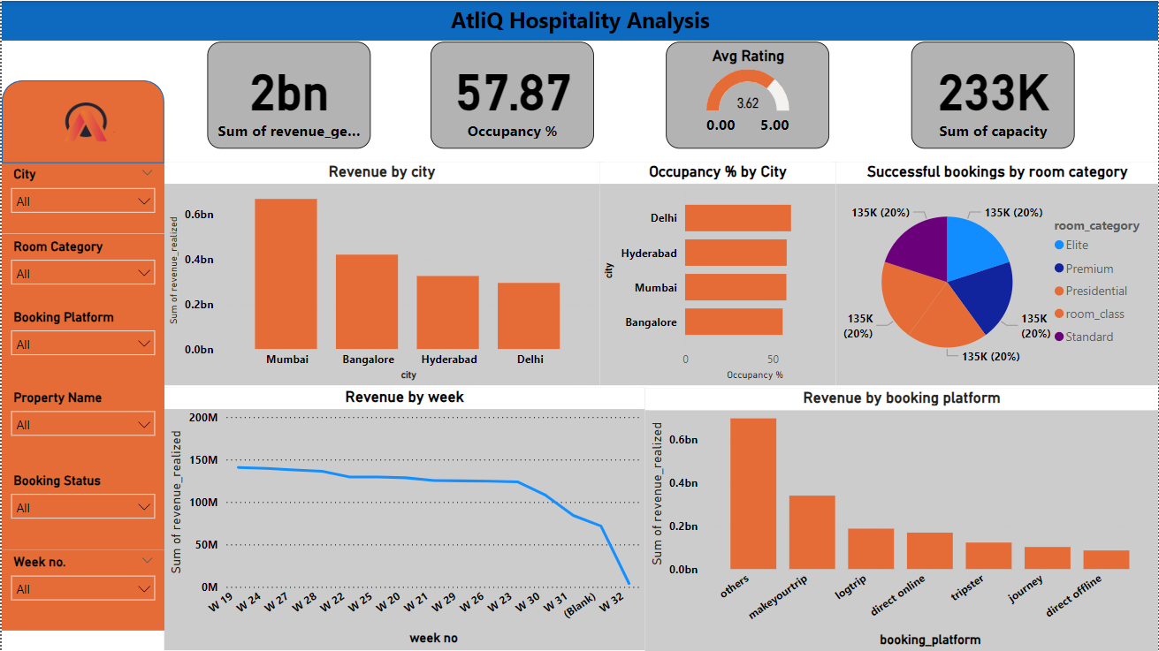
Dashboard

Slide 4
Thank you

